Slide 1
7.2 CASH
Professor Burnes
Leeds School of Business
University of Colorado Boulder
Leeds
B U S I N E S S
Page 1

Slide 2
MT1
Grading should be complete over the weekend
Remember this is a PIECE of your work portfolio

Slide 3
TODAY
Talk CASH
Statement of Cash Flows
Working Capital
Net Working Capital
Cash Burn
Cash Build
Net Cash Burn
Runway Implications
Review the Expectations for the Tesla Case

Slide 4
CASH CASH CASH
What do we mean when we talk about CASH

Slide 5
Statement of Cash Flows
The Statement of Cash Flows Gives Us:
Cashflows to/from Operations
Cashflows to/from Investments
Cashflows to/from Financing
1
2
3

Slide 6
Let’s Take A Look
Please see the Cashflows tab of the Week7.1 excel sheet
Let’s look at from which Financial Statement the cash comes
Now note if it is a single value (comes from Income Statement), or is a difference (comes from Balance Sheet)
Let’s fill in column E, Please WAIT before you calculate the totals for each section
NOTICE – in column A, I have shown whether you will ADD or SUBTRACT the number you get in column E. That is, for example, if Accounts Receivable INCREASES between years, this is TAKING AWAY cash – that is, you counted it as Revenue, but you have NOT COLLECTED it yet!
Calculate the Net Change in Cash
What was the Cash at the Beginning of the Year?
Calculate Cash at End of Year
Complete your Balance Sheet

Slide 7
Working Capital
Working Capital = Current Assets – Current Liabilities
This is a high level liquidity view of a business….
Is this business able to meet near term expenses
It also shows us how much capital is “tied up” in the business, vs deployed through Assets/Investments
**NOTE -- While we currently think of ‘short term’ as a year, depending on the phase of start up, short term can be a quarter, a month… or less

Slide 8
Let’s look at the 7.2 spreadsheet
Calculate the 2023 Working Capital

Slide 9
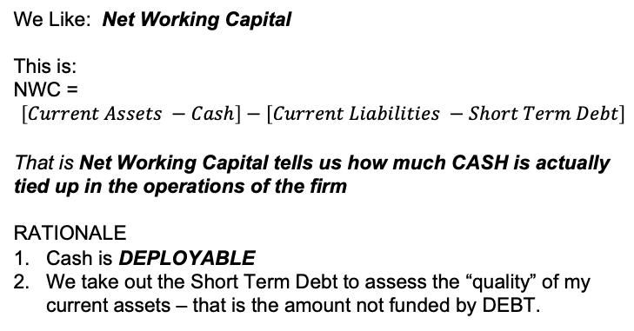
Net Working Capital
We Like: Net Working Capital
This is:
NWC =
$$\left[Current Assets −Cash\right]−\left[Current Liabilities −Short Term Debt\right]$$
That is Net Working Capital tells us how much CASH is actually tied up in the operations of the firm
RATIONALE
Cash is DEPLOYABLE
We take out the Short Term Debt to assess the “quality” of my current assets – that is the amount not funded by DEBT.

Slide 10
Let’s look at the 7.2 spreadsheet
Calculate the 2024 Net Working Capital
What has changed?
Discuss this change/interpretation with your neighbor

Slide 11
Do we use Average or Actual Current Assets, Inventories, Liabilities…
Always check expectations and assumptions
Check WHAT MAKES SENSE
For our work, especially working with companies in high growth, we want ACTUAL. AVERAGE is going to overstate the PAST, rather than set more likely EXPECTATIONS for future performance.

Slide 12
EXAMPLE
 | Year One | Year Two | NWC Averages | NWC Actuals
Current Assets | 450 | 680
Cash | 80 | 180
Current Liabilities | 185 | 335
Short Term Debt | 0 | 120

Slide 13
CASH Burn and CASH Build
This is another way of using the financial statements to understand how a firm is burning and building cash.
It also creates a way to evaluate a RATE of burning and building
IT ALSO creates a way to look at the NET Burn (or build), and in the case of a NET BURN, evaluate the RUNWAY, -- how long does this firm have given its Cash position, and NET BURN RATE

Slide 14
Cash BURN
Cash BURN: Cash that a venture expends on operating, financing and investing
Cash BURN =
COGS + OPEX + R&D + Interest + Taxes
+ Change in Inventories - Change in A/P – Change Other Liabilities
+ CAPEX
Let’s build the Cash Burn for TechInc

Slide 15
Cash BUILD
Cash Build =
Revenue – Change in Receivables
Let’s Calculate the Net Cash BUILD for TechInc

Slide 16
Net Cash Burn
Net Cash Burn = Cash Burn – Cash Build
Let’s Calculate this for Tech Inc.
Is it > or < 0?
In this case it is > 0, that is they are BUILDING cash
Indicative Example
What if it was < 0 … that is - 424.
What would this mean on a monthly basis (assuming uniformly distributed)
It would mean that they are burning ~ $33/month
How much Cash do they have??
$76….
How many months do they have? 76/33 = 2.3 months

Slide 17
CASH
Statement of Cash Flows
Working Capital
Net Working Capital
Cash Burn
Cash Build
Net Cash Burn
See p. 187, #2

Slide 18
1st Case, TESLA
Written Reports:
Team 3
Team 6
Dude Diligence
Presenting:
Dude Diligence
Responding:
B-Team
Team 4
Team 3

Slide 19
CASH is the theme we will focus on with Tesla
Cash Burn, Build, Net Burn
Each Area of Statement of Cash Flows
Equity Multiplier
Liquidity
When you give your recommendation, note that the quality of your calculations, market understanding, and logic drive the success of your work.

Slide 20
Rubrics
Please see the Rubrics in the Group Project Section.
The Rubrics for Written and Presented work are provided.

Slide 21
Next Week
Sunday at 8:00 PM TESLA PRE QUIZ OPENS
Monday at 12:30 first presentation. Discussion. Dr Burnes presents takeaways, calculations.
Monday at 2:00 pm your Case Response opens.
Wednesday: Forecasting and MANAGING Cash Needs

